Slide 1
Project presentation Diabetes prediction using python
BY
Reena.p
Shankari.s

Slide 2

DIABETES
Diabetes has become one of the major causes of national disease and death in most countries.
According to the International Diabetes Federation report, the figure is expected to rise to more than 642 million in 2040, so early screening and diagnosis of diabetes patients have great significance in detecting and treating diabetes on time.
Diabetes is a multifactorial metabolic disease, its diagnostic criteria is difficult to cover all the ethology, damage degree, pathogenesis and other factors, so there is a situation for uncertainty and imprecision under various aspects of medical diagnosis process.

Slide 3
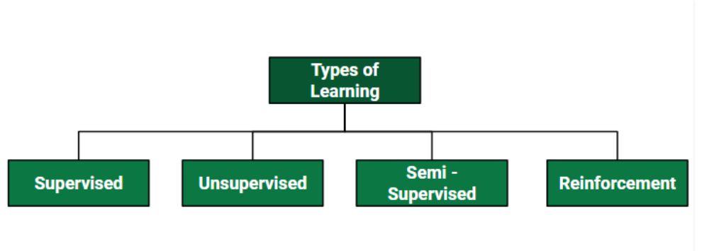
TYPES OF LEARNING
There are different types of
learning in machine learning

Slide 4
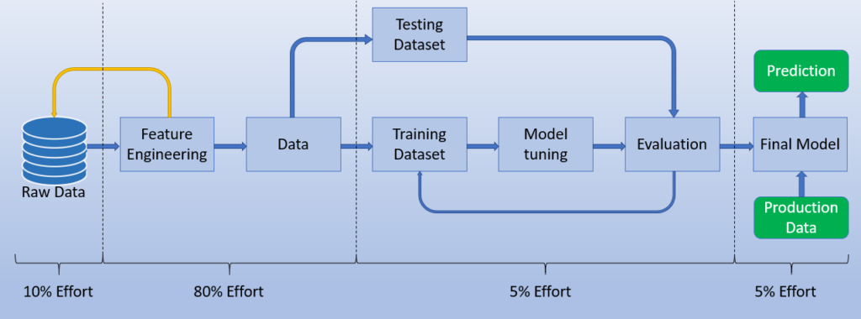
IMPLEMENTATION OF MODEL

Slide 5
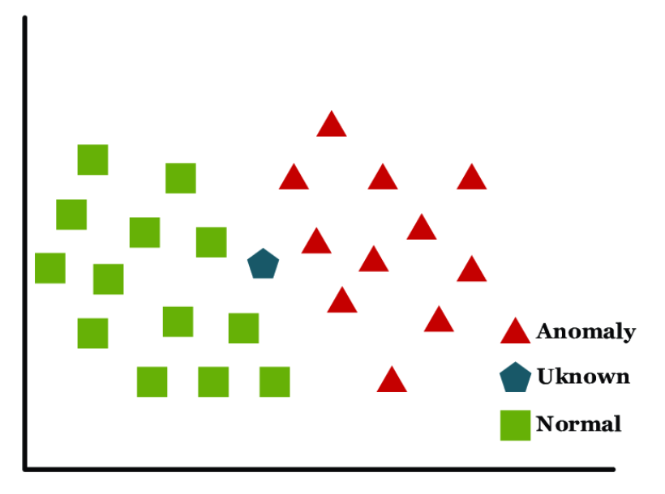
ALGORITHM USED
KNN-Algorithm
A k-nearest-neighbor algorithm, often abbreviated k-nn, is an approach to data classification that estimates how likely a data point is to be a member of one group or the other depending on what group the data points nearest to it are in.

Slide 6
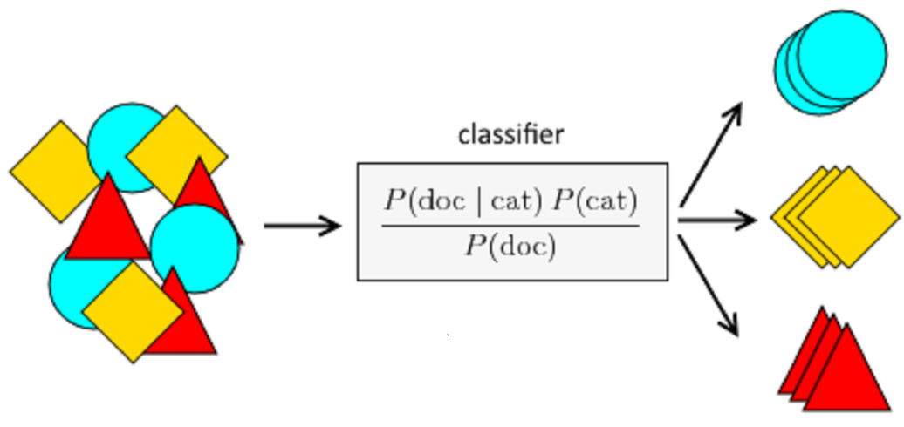
ALGORITHM USED
Naive_Bayes
GaussianNB
Naive Bayes is a simple, yet effective and commonly-used, machine learning classifier. It is a probabilistic classifier that makes classifications using the Maximum A Posteriori decision rule in a Bayesian setting. It can also be represented using a very simple Bayesian network.

Slide 7
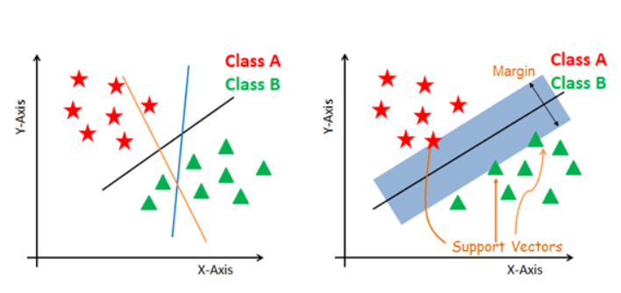
ALGORITHM USED
SVM
The objective of a Linear SVC (Support Vector Classifier) is to fit to the data you provide, returning a "best fit" hyperplane that divides, or categorizes, your data. From there, after getting the hyperplane, you can then feed some features to your classifier to see what the "predicted" class is.

Slide 8
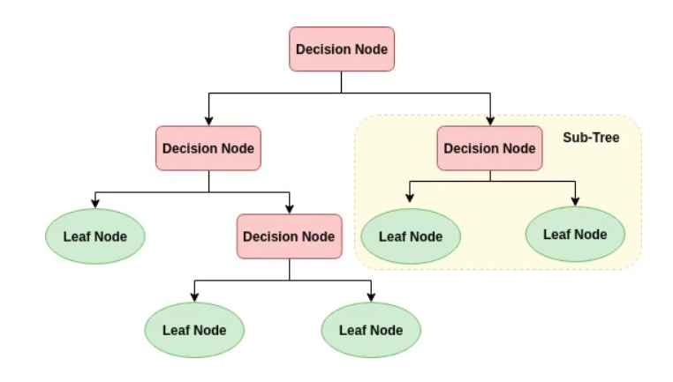
ALGORITHM USED
DecisionTreeClassifier
The decision tree classifier creates the classification model by building a decision tree. Each node in the tree specifies a test on an attribute, each branch descending from that node corresponds to one of the possible values for that attribute.

Slide 9
CONCLUSION
The main aim of this project was to design and implement Diabetes
Prediction Using Machine Learning
Methods and Performance Analysis of that methods and it has been achieved successfully.
The proposed approach uses various classification and ensemble
learning method in which SVM, KNN, Decision Tree are used.
The Experimental results can be assist health care to predict and
make early decision to cure diabetes and save humans life.

Slide 10


